Slide 1
PLANT LEAF DISEASE DETECTION
Using Deep learning
By
Vijay Konakeri
Arihant Girigouda

Slide 2
Agenda
01
Introduction
02
Abstract
03
Product Scope
04
SYSTEM REQUIREMENTS
05
Dataset
06
Sample Images of Dataset
07
Block Diagram
08
Activity Diagram
09
Screenshot of Project
10
Future Work
11
CONCLUSION
12
References

Slide 3
INTRODUCTION
Identification of the plant diseases is the key to preventing the losses in the yield and quantity of the agricultural product. The studies of the plant diseases mean the studies of visually observable patterns seen on the plant. Health monitoring and disease detection on plant is very critical for sustainable agriculture. It is very difficult to monitor the plant diseases manually. It requires tremendous amount of work, expertise in the plant diseases, and also require the excessive processing time. Hence, image processing and Machine learning techniques are used for the detection of plant diseases. Disease detection involves the steps like image acquisition, image pre-processing, image segmentation, feature extraction and classification.
Where as if automatic prediction technique is used it will take less efforts , less time and more accurately . In plants , some general diseases are brown and late scorch , and other fungal , viral and bacterial diseases .

Slide 4
Abstract
Plant disease detection is an Innovative and Enlightening System helping the users to know the disease, trainings or any interesting things taking place around their Area. This Organization aids the native community to keep themselves up to date about the events around their locality or zone or in their town. There are 2 things for this method to work; one for the image processing and another is machine learning

Slide 5
Scope of Project
The study of plant diseases is important as they cause loss to the plant as well as plant produce. The various types of losses occur in the field, in storage or any time between sowing and consumption of produce. The diseases are responsible for direct monitory loss and material loss.

Slide 6
SYSTEM REQUIREMENTS SPECIFICATION
Hardware Requirements
Software Requirements
Processor: 2.5 gigahertz (GHz) frequency or above.
RAM: A minimum of 4 GB of RAM.
Hard disk: A minimum of 20 GB of available space.
Monitor: Minimum Resolution 1024 X 768.
Operating System: Windows 7 and above.
Programming language: Python 2.7 and above. HTML, CSS, Java Script Platform: Jet Brains PyCharm Community Edition 2018.3.5 x64
Supporting Libraries: Tensor Flow, Pandas, Flask, numpy, sklearn, Keras etc…….

Slide 7
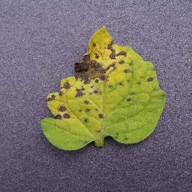
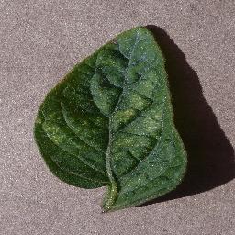
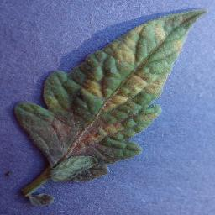
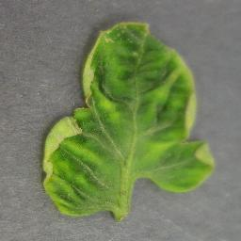
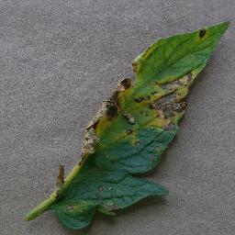
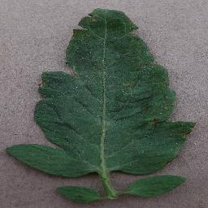
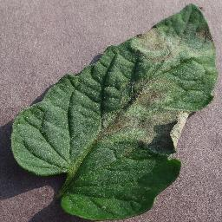
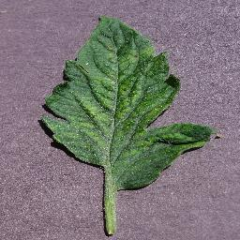
Sample Images of Dataset
Septoria leaf spot
Two-spotted Spider mite
Leaf Mold
Yellow Leaf Curl Virus
Early blight
Bacterial spot
Late light
Mosaic virus

Slide 8
Block Diagram –Workflow of plant leaf disease prediction
Dataset Creation
Train, Test, Val
CNN Design
Pre-Processing
Training
Model
Load Model Test
Pre-Process
Input Image
Classification

Slide 9
Activity Diagram
Select/Upload Leaf Image
Pre-Processing
Feature Extraction
Abnormal
NN Classification
Remedies
Abnormal

Slide 10
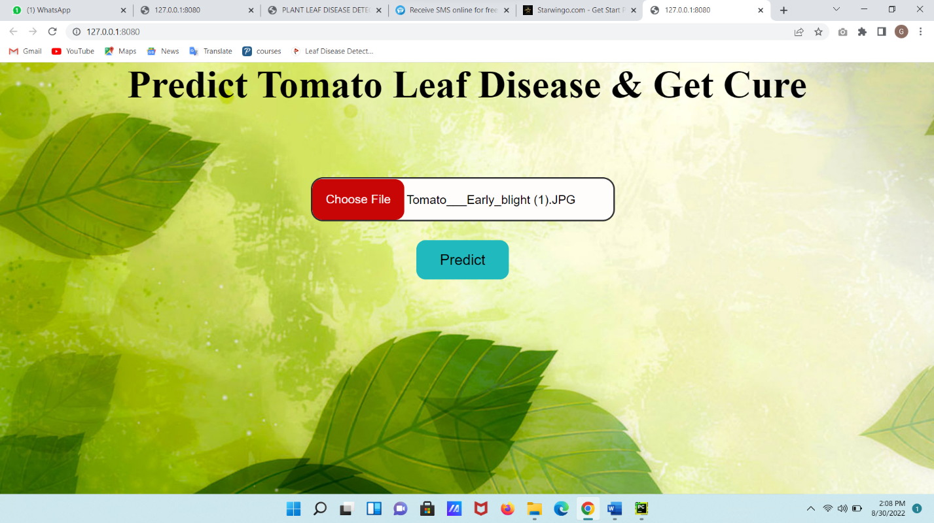
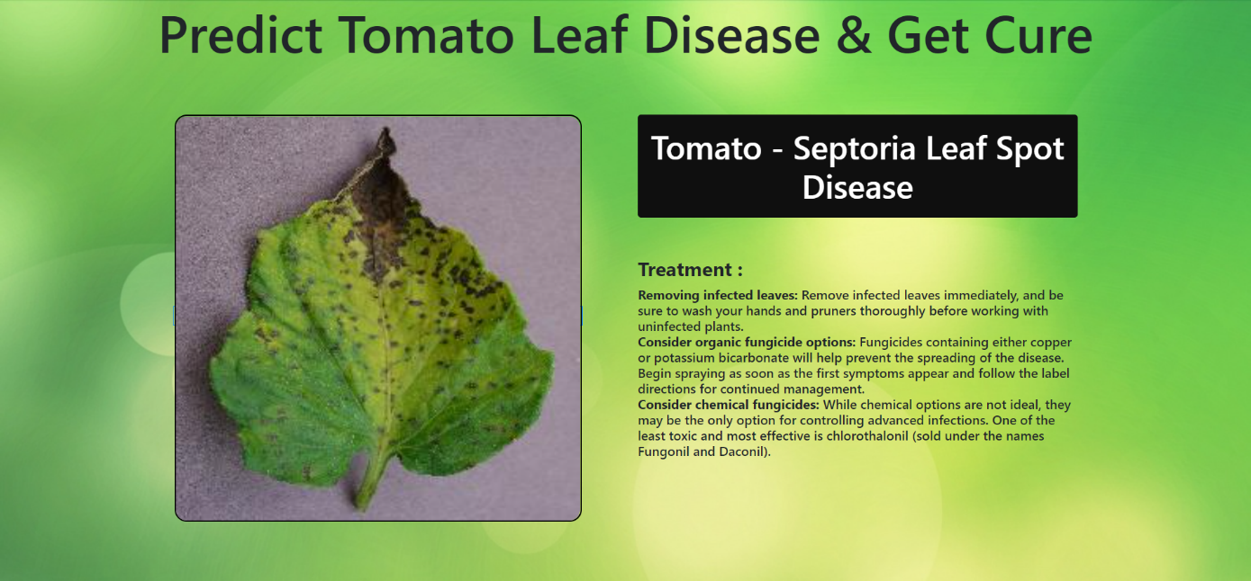
Screenshot of Project

Slide 11
FUTURE WORK
To improve recognition rate of final classification process hybrid algorithms like Artificial Neural Network, Bays classifier, Fuzzy Logic can also be used.
Mobile application can be developed which is handy and easy to use.
An extension of this work will focus on automatically estimating the severity of the detected disease.
As future enhancement of the project is to develop the open multimedia (Audio/Video) about the diseases and their solution automatically once the disease is detected.

Slide 12
CONCLUSION
To improve There are number of ways by which we can detect disease of plants and suggest remedies for them. Each has some pros as well as limitations. On one hand visual analysis is least expensive and simple method, it is not as efficient and reliable. Image processing is a technique which is most spoken for very high accuracy and least time consumption are major advantages offered. The applications of K-means clustering and Neural Networks (NNs) have been formulated for clustering and classification of diseases that effect on plant leaves. Recognizing the disease accurately and efficiently is mainly the purpose of the proposed approach. The experimental results indicate that the proposed approach is a valuable approach, which can significantly support an accurate detection of leaf diseases in a little computational effort. Alongside the supply of cultivation tools, the farmers also need access to accurate information that they can use for efficient crop management and there is no better way than providing them a service that they can use through the software.

Slide 13
References
1. A survey on crop disease detection using image processing technique for economic growth of rural area. Yashpal Sen1, Chandra Shekhar Mithlesh2, Dr. Vivek Baghel3
2. K. Elangoran, S. Nalini, 2011 “Detection and classification of leaf diseases using K- means-based segmentation and neural-networks-based classification.” Inform. Technol. J., 10: 267-275. DOI: 10.3923/itj.2011.267.275.
3. Sandesh Raut, Karthik Ingale, “Review on leaf disease detection using Image Processing techniques.”
4. “A Survey on Methods of Plant Disease Detection” Sagar Patil, Anjali Chandavale
5. T. RUMPF, A-K Mahlein, U sleiner, H. W. Dehne. "Texture analysis for diagnosing paddy disease." In International Conference on Electrical Engineering and Informatics, 2009. ICEEI'09., vol. 1, pp. 23-27. IEEE, 2009.
6. “Plant disease detection and classification using image processing and artificial neural networks.” Mr. Sanjay Mirchandani1, Mihir Pendse2, Prathamesh Rane3, Ashwini Vedula4
7. “Detection and Classification of Plant Leaf Diseases Using Image Processing Techniques:” Savita N. Ghaiwat, Parul Arora
8. “Image Processing Based Leaf Rot Disease, Detection of Betel Vine (Piper Betel.)” Amar Kumar Deya*, Manisha Sharmaa, M.R. Meshramb
9. “Advances in image processing for plant disease detection” Jayamala k Patil, Rajkumar 10. S Arivazhagan, R Newlin shebiah, S Ananthi, S Vishnu varthini “Detection of unhealthy region of plant leaves and classification of plant leaf diseases using texture features.”

Slide 14
Thank You!

